Slide 1


Slide 2
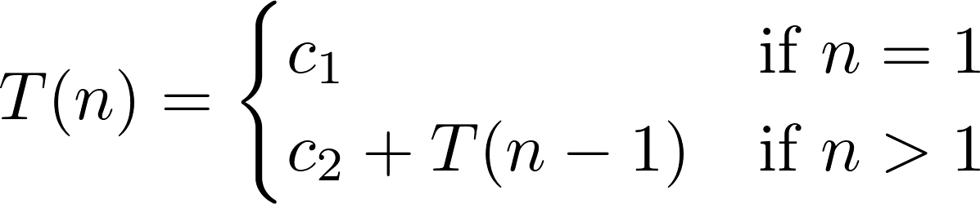
Factorial
http://www.wolframalpha.com/
T(n) = c_2 + T(n-1)
T(n) = c_2*n + c_1
Notes:
\[
T(n) =
\begin{cases}
0 & \text{if $n=1$} \\
1 & \text{if $n=2$} \\
T(\Floor{n/2}) + T(\Ceil{n/2}) + 2 & \text{if $n>2$}
\end{cases}
\]

Slide 3
Factorial
http://www.wolframalpha.com/
T(n) = c_2 + T(n-1)
T(n) = c_2*n + c_1
T(n) es O(c_2*n + c_1), por definición de O
T(n) es O(c_2*n), por Regla de la Suma
T(n) es O(n), por Regla del Producto
Notes:
\[
T(n) =
\begin{cases}
0 & \text{if $n=1$} \\
1 & \text{if $n=2$} \\
T(\Floor{n/2}) + T(\Ceil{n/2}) + 2 & \text{if $n>2$}
\end{cases}
\]

Slide 4
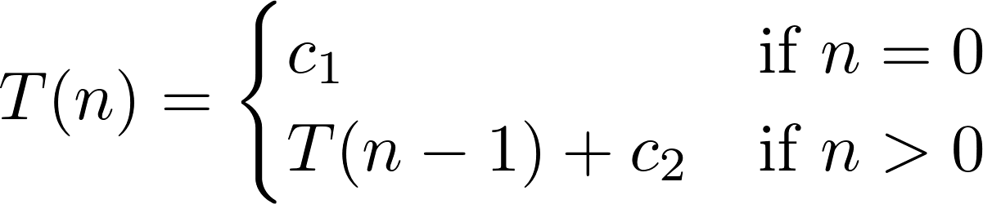
Array6
http://www.wolframalpha.com/
T(n) = c_2 + T(n-1)
T(n) = c_2*n + c_1
Notes:
\[
T(n) =
\begin{cases}
0 & \text{if $n=1$} \\
1 & \text{if $n=2$} \\
T(\Floor{n/2}) + T(\Ceil{n/2}) + 2 & \text{if $n>2$}
\end{cases}
\]

Slide 5
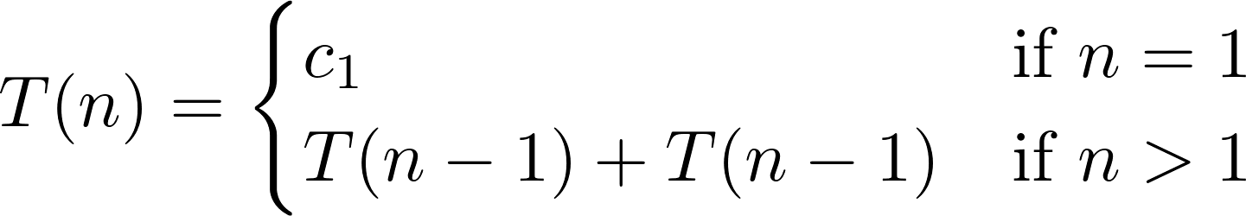
Hanoi
http://www.wolframalpha.com/
T(n) = T(n-1) + T(n-1)
T(n) = c_2*2^(n-1)
Notes:
\[
T(n) =
\begin{cases}
0 & \text{if $n=1$} \\
1 & \text{if $n=2$} \\
T(\Floor{n/2}) + T(\Ceil{n/2}) + 2 & \text{if $n>2$}
\end{cases}
\]

Slide 6
Hanoi
http://www.wolframalpha.com/
T(n) = T(n-1) + T(n-1)
T(n) = c_2*2^(n-1)
T(n) es O(c_2*2^(n-1)), por Definición de O
T(n) es O(2^(n-1)) , por Regla del Producto
T(n) es O(2^n), por Regla del Producto
Notes:
\[
T(n) =
\begin{cases}
0 & \text{if $n=1$} \\
1 & \text{if $n=2$} \\
T(\Floor{n/2}) + T(\Ceil{n/2}) + 2 & \text{if $n>2$}
\end{cases}
\]

Slide 7
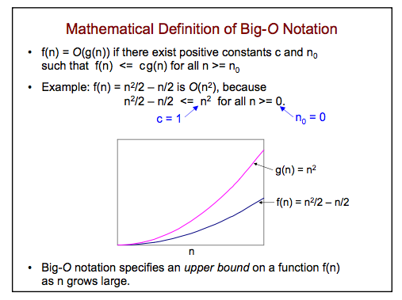
Notes:
\[
T(n) =
\begin{cases}
0 & \text{if $n=1$} \\
1 & \text{if $n=2$} \\
T(\Floor{n/2}) + T(\Ceil{n/2}) + 2 & \text{if $n>2$}
\end{cases}
\]

Slide 8
O-notation
http://bigocheatsheet.com/
Notes:
\[
T(n) =
\begin{cases}
0 & \text{if $n=1$} \\
1 & \text{if $n=2$} \\
T(\Floor{n/2}) + T(\Ceil{n/2}) + 2 & \text{if $n>2$}
\end{cases}
\]

Slide 9
ArrayMax
3 | 5 | 8 | 1
ArrayMax(3,{3,5,8})
ArrayMax(2,{,5,8})
ArrayMax(n, arr[]){
N > arr[]
max=n
}
ArrayMax(1,{8})
Return 8

Slide 10
Le resto el número al
Target. Si es 0 devuelve verdadero
groupsum
3 | 6 | 4
7
1
1
target=7
4
4
0
true

Slide 11
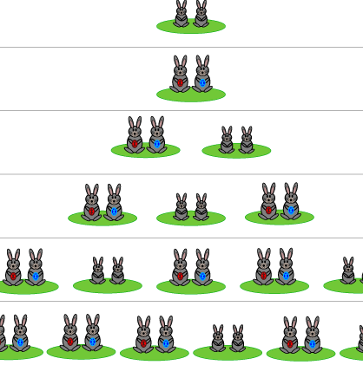
Fibonacci
Click a la imagen,
video

